Slide 1
IT2060/IE2061
Operating Systems and System Administration
Lecture 01
Introduction to Operating System

Slide 2
Introduction
Learn the major components of the operating systems
Practice with utilities of Unix system administration.
Students will also apply the knowledge they learn in the lectures, tutorial and labs to complete the unit's programming assignment

Slide 3
Method of Delivery
2 Hours Lecture
1 Hour Tutorial
2 Hours Practical
Attendance will be marked.

Slide 4
Assessment Criteria
Mid Term Test (Online) 20% Lessons 1 to 5
Assignment (Online) 20% Based on Practical Sessions (C Language)
Final Examination (Written) 60% Lessons 6 to 12

Slide 5
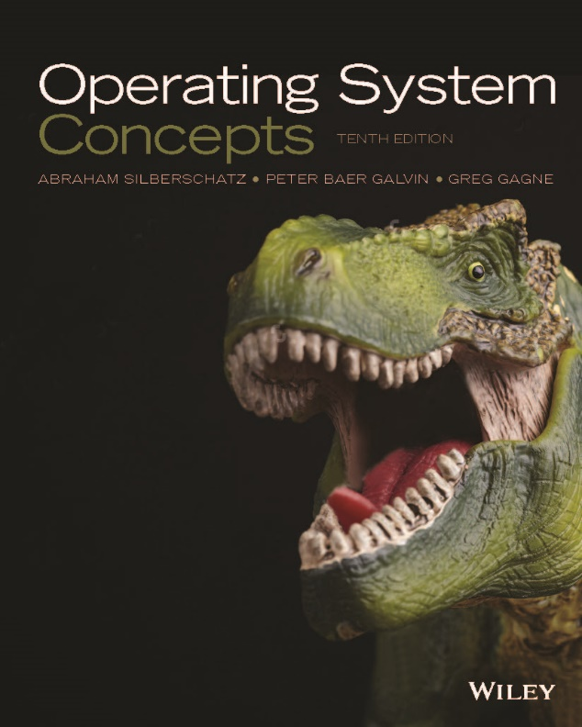
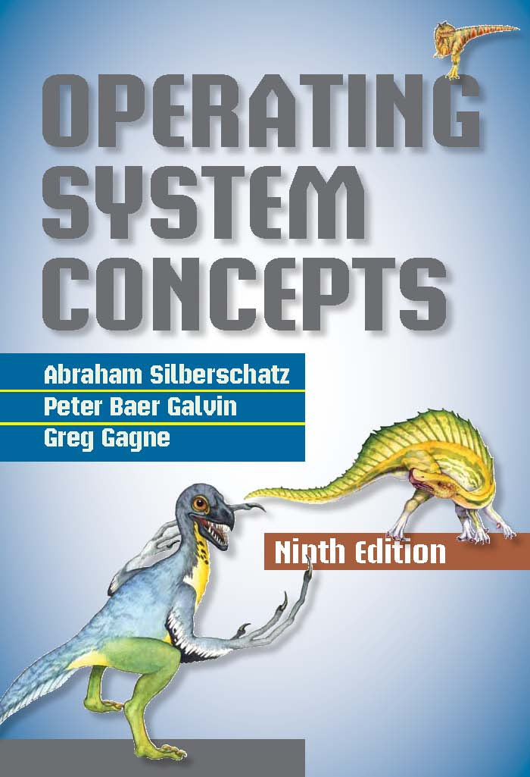
References
A. Silberschatz, P.B. Galvin, G. Gagne, Operating System Concepts, 10th Edition, John Wiley & Sons, 2018

Slide 6
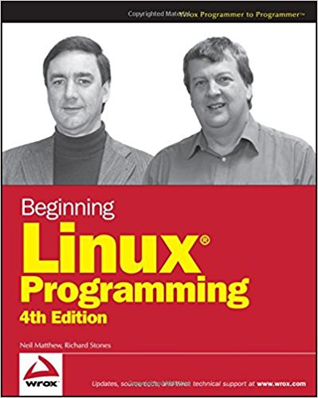
Linux Programming
Beginning Linux Programming
4th Edition
by Neil Matthew Richard Stones
PThreads Primer
A Guide to Multithreaded Programming
Bil Lewis Daniel J. Berg

Slide 7
Computer System Structure
Computer system can be divided into four components:
Hardware – provides basic computing resources
CPU, memory, I/O devices
Operating system
Controls and coordinates use of hardware among various applications and users
Application programs – define the ways in which the system resources are used to solve the computing problems of the users
Word processors, compilers, web browsers, database systems, video games
Users
People, machines, other computers

Slide 8
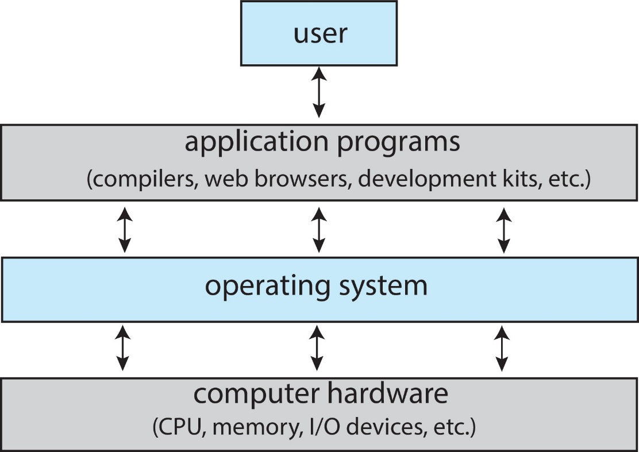
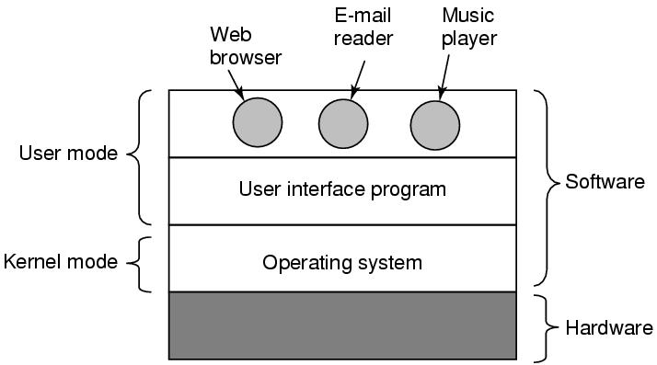
Abstract View of Components of Computer

Slide 9
What is an Operating System?
An Operating System is a program that acts as an intermediary/interface between a user of a computer and the computer hardware.
OS goals:
Control/execute user/application programs.
Make the computer system convenient to use.
Ease the solving of user problems.
Use the computer hardware in an efficient manner.

Slide 10
Purposes of OS:
Provide the environment for program execution and development
Manage the resources (CPU, memory, IO devices, hard disk, files etc..)
Provide the access controlling (username and password)

Slide 11

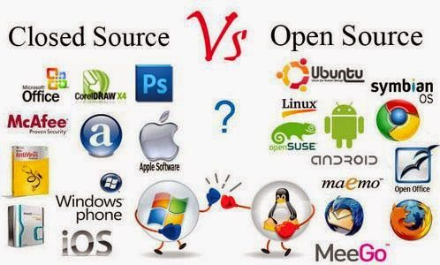
Types of OS

Slide 12
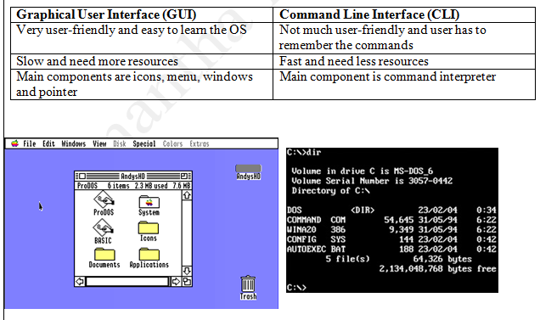
User Interface of the Operating System

Slide 13
OS Components
Process Management
Main-memory management
Secondary-storage management
File Management
I/O System Management
Protection System
Networking (Distributed Systems)
Command- interpreter System

Slide 14
OS Services
For helping users:
Provide user interface (UI)
Command line interface – using text commands
Batch interface – commands and their directives are put in a file
Graphical user interface (GUI) – window system with pointing devices
Provide environment for program execution.
OS must load program and run it.
Program must end normally or abnormally.
Provide some means to do I/O
user programs cannot execute I/O operations directly.
Provide mechanism to do file-system manipulation.
Capability to read, write, create, and delete files, directory trees etc.
Provide mechanism for process communication.
Exchange information between processes executing on the same computer or on different systems through a network.
Implemented via shared memory or message passing.
Detect errors and take appropriate actions to ensure correct and consistent computing.
Detect errors in CPU and memory hardware, in I/O devices, or in user programs.

Slide 15
OS Services
For efficient operation:
Resource allocation
Allocating resources to multiple users or multiple jobs running at the same time (CPU scheduling, etc.).
Accounting
Keep track of and record which users use how much and what kinds of computer resources for account billing or for accumulating usage statistics .
Protection and security
Ensuring that all access to system resources is controlled (access permissions, etc.).

Slide 16
System Calls
A system call is a user interface to the OS services
Available in assembly-language instructions or in high level languages for systems programming (e.g., C)
E.g., fork () is a system call to ask OS to create a new process
Application Program Interface (API): a set of functions available to an application programmer.
An API typically invokes the actual system calls for the application programmers.
Examples of API: Windows API, POSIX API, Java API
API is more portable and simpler to use

Slide 17
System Calls (contd. )
System call result/termination.
Normal termination (exit or return).
Terminate current program and return to the command interpreter.
Abnormal termination (trap) ⎯ program error.

Slide 18
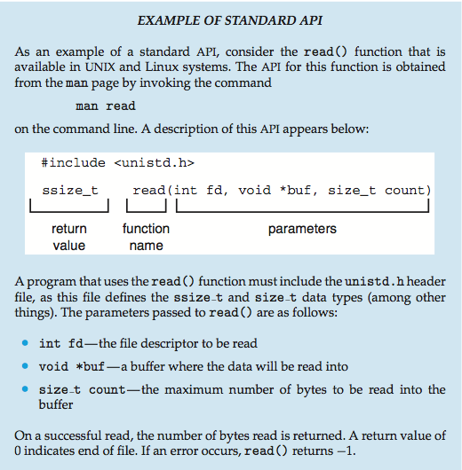

Slide 19
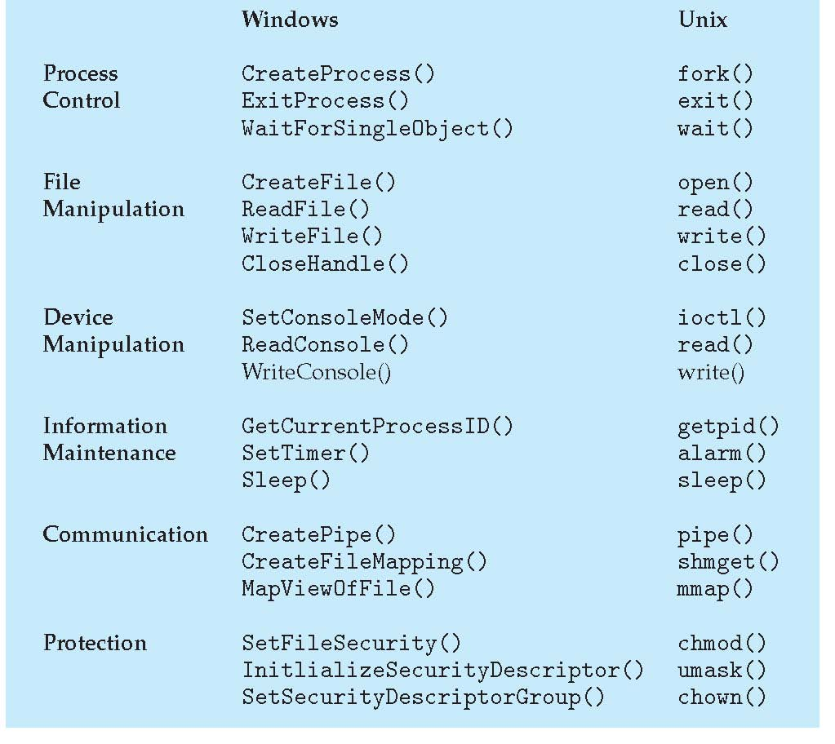

Slide 20
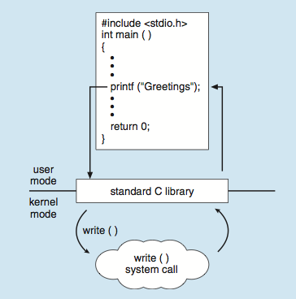

Slide 21
System Calls (cont. )
Types of system calls
1) Process control
End, abort (running program); Load, execute; Create, terminate; Signal event, etc.
Examples: fork(), exit(), wait(), etc.
2) File management
Create, delete; Open, close; Read, write, reposition; Get and set file attributes, etc.
Examples: open(), read(), write(), close(), etc.
3) Device management (memory, tape drives etc.)
Request device; Release device; Read, write, reposition, etc.
Examples: ioctl(), read(), write(), etc.
4) Information maintenance
Get or set time or date; Get or set process attributes, etc.
Examples: getpid(), alarm(), sleep(), etc.
5) Communications
Create, delete communication connection; Send and receive messages, etc.
Examples: pipe(), shmget(), mmap(), etc.
6) Protection
Resource access control
Examples: chmod(), umask(), chown(), etc.

Slide 22
System programs or utilities
Provide a convenient environment for program development and execution
Most users’ view of the OS is defined by system programs, not the actual system calls.
Some of them are simple user interface to system calls.
System programs can be divided into:
File manipulation: Create, delete, copy, rename, print, dump, list.
Status information: Date, time, memory, disk space, number of users.
File modification: Text editors to create and modify content of files.
Programming-language support: Compilers, interpreters, assemblers.
Program loading and execution: Absolute, Relocatable, Overlay loaders.
Communication: Programs that provide the mechanism for creating virtual connections among processes, users, and different computer systems.

Slide 23
Operating System Design Goals
Design of the OS is affected by the hardware choice, and system type (batch, timeshared, etc.)
User goals – OS should be convenient to use, easy to learn, reliable, safe, and fast.
System goals – OS should be easy to design, implement, and maintain, as well as flexible, reliable, error-free, and efficient
Separation of policy and mechanism is a very important principle
It allows maximum flexibility if policy decisions are to be changed later.
Mechanisms determine how to do something
Policies decide what will be done.
Policies are likely to change from place to place and time to time, and therefore a general mechanism would be more desirable.
Example: A mechanism for ensuring CPU protection is the timer construct; and the decision on how long the timer is set for a particular user is a policy decision.

Slide 24
OS Operation
In multiprogramming, OS must ensure that an incorrect (or malicious) program cannot cause other programs to execute incorrectly.
Many programming errors are detected by the hardware, and the errors are normally handled by the OS.
Dual-mode operation
Hardware provides at least two modes of operations:
User mode – in which user programs run.
Monitor mode, also called Supervisor, System, or privileged mode.
Mode bit is provided by the hardware to indicate the current mode: monitor (0) or user (1).

Slide 25
OS Operation (cont.)
Dual-mode operation (cont.)
Some machine instructions that may cause harm are designated (by hardware) as privileged instructions.
E.g., the MSB of the machine code of the instruction is a bit ‘1’
A privileged instruction can be executed only in monitor mode.
At system boot-time the hardware starts in monitor mode → OS is loaded.
OS starts user processes in user mode; a user process could never gain control of the computer in monitor mode.
When an interrupt or fault occurs hardware switches to monitor mode.
Set user mode
monitor
user
Interrupt/fault

Slide 26
OS Operation (cont.)
I/O
All I/O instructions are privileged instructions.
How does the user program perform I/O ? Use system call.
Usually takes the form of a trap to a specific location in the interrupt vector.
Control passes through the interrupt vector to a service routine in the OS, and the mode bit is set to a monitor mode.
The monitor verifies that the parameters are correct and legal, executes the request, and returns control to the instruction following the system call.

Slide 27
OS Operation (cont.)
Memory
System must provide memory protection at least for the interrupt vector and the Interrupt Service Routine.
Use two registers that determine the range of legal addresses a program may access:
Base register – holds the smallest legal physical memory address.
Limit register – contains the size of the range.
Memory outside the defined range is protected.
The load instructions for the base and limit registers are privileged instructions.
OS has unrestricted access to monitor and user memory.

Slide 28
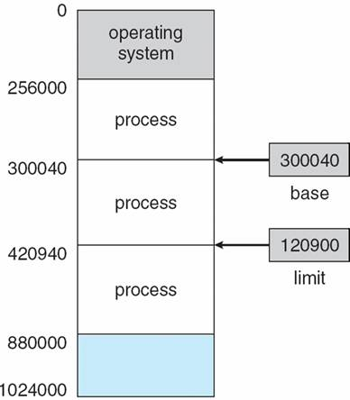
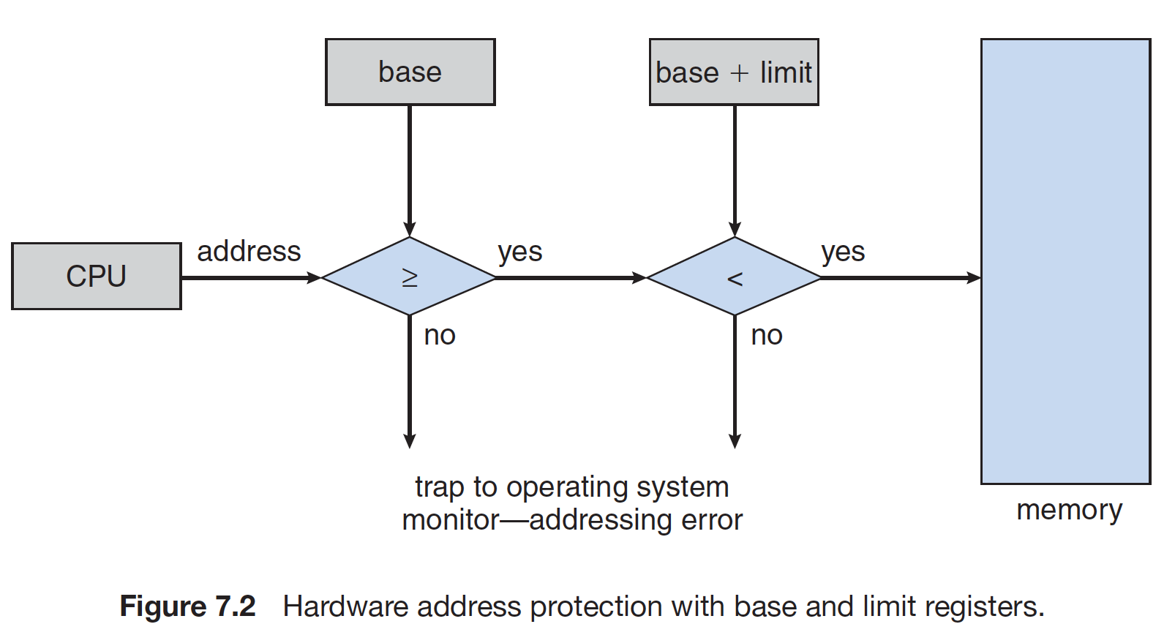
Memory Protection

Slide 29
OS Operation (cont.)
CPU
System must prevent one user program using CPU all the time
Because of getting stuck in an infinite loop, or non-fair users
Use timer interrupt after specified period to ensure OS maintains control
Timer is decremented every clock tick.
When timer reaches value 0, an interrupt occurs.
Timer is commonly used to implement time sharing.
Timer is also used to compute the current time.
Loading timer value is a privileged instruction. Why?

Slide 30
OS development (cont.)
Simultaneous Peripheral Operation OnLine (SPOOL):
Goal: To keep I/O and CPU busy all the time.
Use a faster disk as huge buffer → disk was a new technology
Inputs from cards are read into disks.
CPU reads input from disks and outputs are written by CPU to disks.
The I/O of a job is overlapped with its own computation or with another job.
Need a Job Pool – data structure that allows OS to select job that runs next in order to increase CPU utilization → job scheduling
Card
Reader
CPU
Line
Printer
Disk

Slide 31
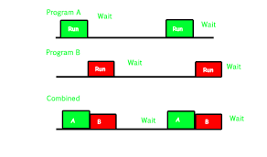
Multiprogramming
Goal: to increase the CPU utilization
Several jobs are kept in main memory at the same time, and the CPU is multiplexed among them
It needs these OS features:
Job scheduling → OS chooses jobs in the job pool and put them into memory.
Memory management → OS allocates the memory for each job.
CPU scheduling → OS chooses one among the jobs in memory (called processes) that is ready to run.
I/O allocation.
Memory partition
OS
Job 1
Job 2
Job 3

Slide 32
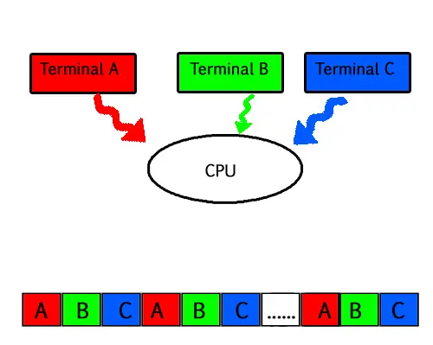
Time-Sharing/Multitasking Systems
Goal: to provide interactive use of computer system at reasonable cost (one computer – several users/jobs).
It is a variant of multiprogramming → but user input is from on-line terminal.
CPU is multiplexed among jobs in memory frequently (≤1 sec?) so that users can interact with their running program.
Today, most systems provide both batch processing and time sharing.

Slide 33
Real-time Systems
Well-defined fixed-time constraint – the system is functional if it returns the correct result within the time constraint.
Hard real-time system.
Guarantees that critical tasks complete on time.
Often used as a control device in a dedicated application
controlling scientific experiments, medical imaging systems, industrial control systems, and some display systems
Secondary storage is limited or absent
data is stored in short-term memory, or in ROM.
Soft real-time system
A critical-time task gets priority over others until it completes.
Limited utility in industrial control robotics.
Useful in applications (multimedia) requiring advanced OS features.

Slide 34
Thank You

